Slide 1
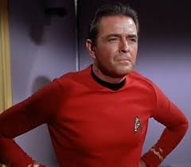
Text Analysis of President Trump News Coverage
PREDICT 453, Spring 2018
Mark Heiple
I’m an engineer, not an artist!

Slide 2
12 DSIs were selected from the entire corpus, spanning Cohorts 7 – 12 (Spring 2018) DSI-15, Trump Insists Mexico Will Pay for Wall After U.S. Begins Work DSI-18, House GOP, Trump team hatch border wall plan DSI-22, Trump acknowledges Russia role in U.S. election hacking DSI-38, Tillerson on North Korea: Military action is 'an option' DSI-61, Trump says this is all a hoax. Mueller, Congress and Facebook disagree DSI-66, Preventative War Revisited DSI-77, White House seeks $18B to extend border wall over next 10 years DSI-80, President Trump's Biggest Foreign Policy Headache For 2018 DSI-89, Trump Administration Wants More Control Over U.S. Lands for Border Wall DSI-93, Trump and Western Allies Expel Scores of Russians in Sweeping Rebuke Over U.K. Poisoning DSI-94, White House confirms Trump, Putin discussed Washington summit DSI-103, A U.S.-North Korea summit: What could possibly go wrong?
Introduction
The project focused on the text analytics of 3 main topics of the Trump administration. The purpose of the project is to determine if terms from these DSIs can be used as a model for clustering other news DSIs into one of these clusters.
Border Security
North Korea
Russia

Slide 3
Analysis Progressed through several steps
Extract Terms
Create equivalence classes
Create RTV
Create/Refine Ontology
Refine RTV
Analysis
Hierarchal Clustering
K-Means
LDA

Slide 4
Summary of Results
Both Hierarchical K-Means Clustering indicate 3 strong clusters, with fairly significant
sub-clusters. Term frequency of each cluster was used to create Cluster Term Vectors that describe each cluster.
Border Security with Mexico
North Korea Denuclearization
Preventative war
Diplomatic discussion
Russia
2016 Presidential election interference
Foreign relations
Topic modeling using Latent Direchlet Allocation (LDA) produced the same 3 strong top level topics, but different sub-topics
LDA indicates 8 likely topics:
Legal aspects of building border wall.
Planning for pre-emptive war with North Korea
Diplomatic efforts to denuclearize North Korea
Expulsions of Russian diplomats in retaliation of poison attack
Trump exploring diplomatic solutions in response to Russian election interference
Rex Tillerson's threatening North Korea over their nuclear program (similar to #2 but from a slightly different angle)
Russian election interference
Funding aspects of building the border wall.

Slide 5
Extract Terms
FiveFilters (http://fivefilters.org) was used to extract terms
This creates a vector of terms and number of occurrences
The vector was pruned of vague and insignificant terms
Examples:
Mr.
action
country
response
The terms were stemmed, to reduce them a common base
Example: country, countries, country’s -> country

Slide 6
Create Equivalence Classes
Similar terms or terms that have the same meaning are combined into equivalence classes. This serves as dimension reduction (reducing the number of terms). For example, from DSI-93:
"Russia",8
"Russians",4
"Moscow",2
"Kremlin",2
"Russian government",1
"giant neighbor",1
"Russian organizations",1
"cyberattacks",1
"intelligence operations",1
"Britain",8
"British soil",1
"Salisbury",1
"London",1
russia,19
russianHacks,2
britain,11

Slide 7
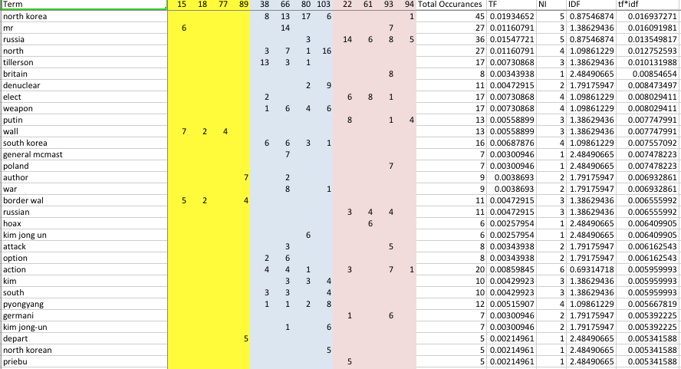
Create Initial RTV
The initial RTV combines the vectors of terms for all of the DSIs into one matrix
One column for each DSI, containing the number of occurrences of each term
Global term frequency (tf) value for each term
Inverse Document Frequency (idf) value for each term
tf*idf value is a measure of term importance

Slide 8
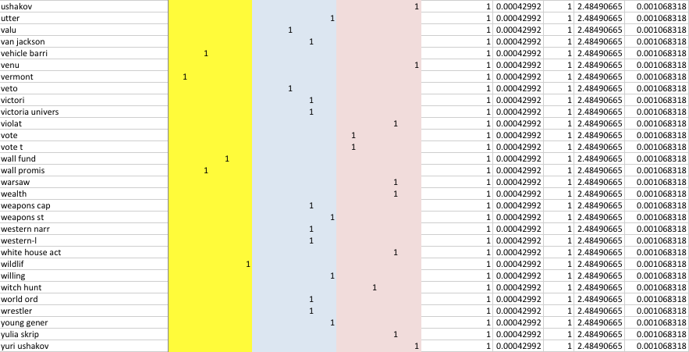
Create Initial RTV
Low value terms, such as those with low tf*idf values or those that only occur once are removed.
Example terms that were removed:

Slide 9
Create Ontology
An Ontology of the three major topics was created to further assist in dimension reduction and to identify topics.
Border Security
North Korea
Russia
Ontology concepts are added to the RTV as additional terms.
Some terms/ECs were combined under ontology concepts
Concepts in the ontology are shown with the number of occurrences for each DSI
Occurrences of child concepts are ‘rolled up’ into the parent concepts and multiplied by 0.5
Example (simplified)
Total Strength of the NK Denuclearization concept for DSI-38
= 2 (NK Denuclearization) +
[ 0 (Diplomacy) +
1 (Sanctions) +
2 (US Military Action)]
* .5 (due to being child concepts)
= 2 + [0 + 1 + 2] *.5
= 3.5
For the Concept NK Denuclearization in the RTV, the column for DSI-38 would have the value 3.5
NK Denuclearization
38:2
66:3
80:3
103:5
Sanctions
38:1
66:2
80:3
US Military Action
38:2
66:7
80:2
Diplomacy
80:3

Slide 10
Ontology: Border Security
mexico
15:5
18:4
77:1
89:3
borderSecurity
77:1
deportationPlan
77:2
borderWall
15:4
18:4
77:10
89:3
homelandSecurity
77:2
89:3
immigrationDaca
15:1
18:1
77:3
89:1
uscbp
18:1
77:2
89:1
wallLegislation
15:4
18:7
77:4
89:1
mexicoPaysForWall
15:4
18:2
wallSupporters
15:1
18:2
wallOpponents
15:3
18:1
77:2
89:1
2006SecureFenceAct
15:1
18:2
landUse
wallCost
15:4
18:4
77:4
89:1
purchasePrivateProperty
18:1
89:1
National Parks
89:1
Environment
89:1

Slide 11
Ontology: North Korea
NK Nuclear Program
38:2
66:3
80:5
103:4
Reduced US Asian Influence
80:2
NK Military Preparedness
66:1
NK objectives
NK looks to gain status
66:1
103:3
NK Denuclearization
38:2
66:3
80:3
103:5
NK Allies
SK Allies
Russia
80:3
China
38:7
66:5
80:4
Japan
66:2
80:2
103:1
Sanctions
38:1
66:2
80:3
US Military Action
38:2
66:7
80:2
SK Defense
Diplomacy
80:3
Troops
38:2
66:1
Tillerson warns NK
38:4
66:3
80:1
Trump warns NK
38:1
80:2
Trump proposes NK Summit
38:1
103:8
Preventative War Opponents
66:2
Cyberattack
66:2
MissileDefense
38:4
Tillerson visits SK
38:1
66:1
NK Deception
103:5

Slide 12
Ontology: Russia
Russia
Gain Influence
22:3
93:1
Russian Relations
22:3
94:2
Summit
94:5
ElectionInterference
22:4
61:6
93:1
94:2
Poisoning
93:6
94:3
Topics
94:5
US Retaliation
Russian Hacking
22:5
61:2
93:1
Sanctions
22:2
93:1
Expulsions
Fake news
22:1
61:2
collusionHoax
61:6
USExpulsions
93:4
94:1
Facebook
61: 4
slantedMedia
61:3
AlliedExpulsions
93:5
Intelligence Agency Investigation
22:6
61:2
British Expulsions
93:2
Russian Expulsions
94:1
InvestigationReport
22:5
61:3

Slide 13
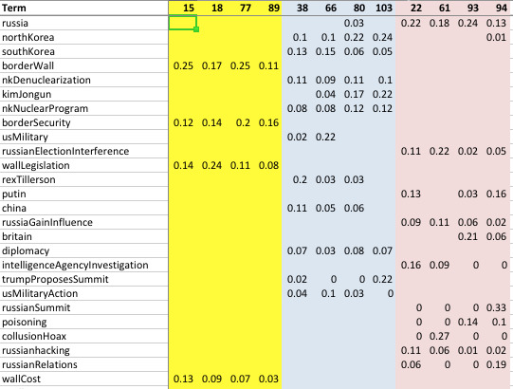
RTV With Ontology Concepts
Example terms from final RTV. DSI columns have the tf*idf value for each term. Terms are sorted in descending order of overall strength.
https://github.com/mark-heiple/P453/blob/master/thinned_combined_out/rtv_tfidf.xlsx

Slide 14

Analysis

Slide 15
Hierarchical Clustering
Hierarchical clustering analysis with 3, 4, and 5 clusters indicate that there are 3 main clusters, with North Korea and Russia split into 2 sub-clusters.
Border Security with Mexico
North Korea Denuclearization
Preventative war
Diplomatic discussion
Russia
2016 Presidential election interference
Foreign relations

Slide 16
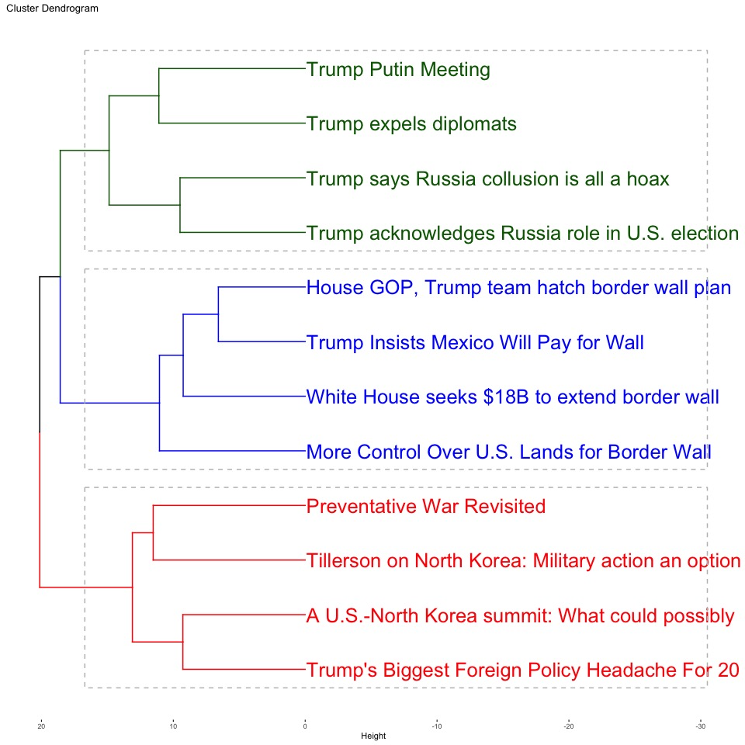
Hierarchical, 3 Clusters

Slide 17
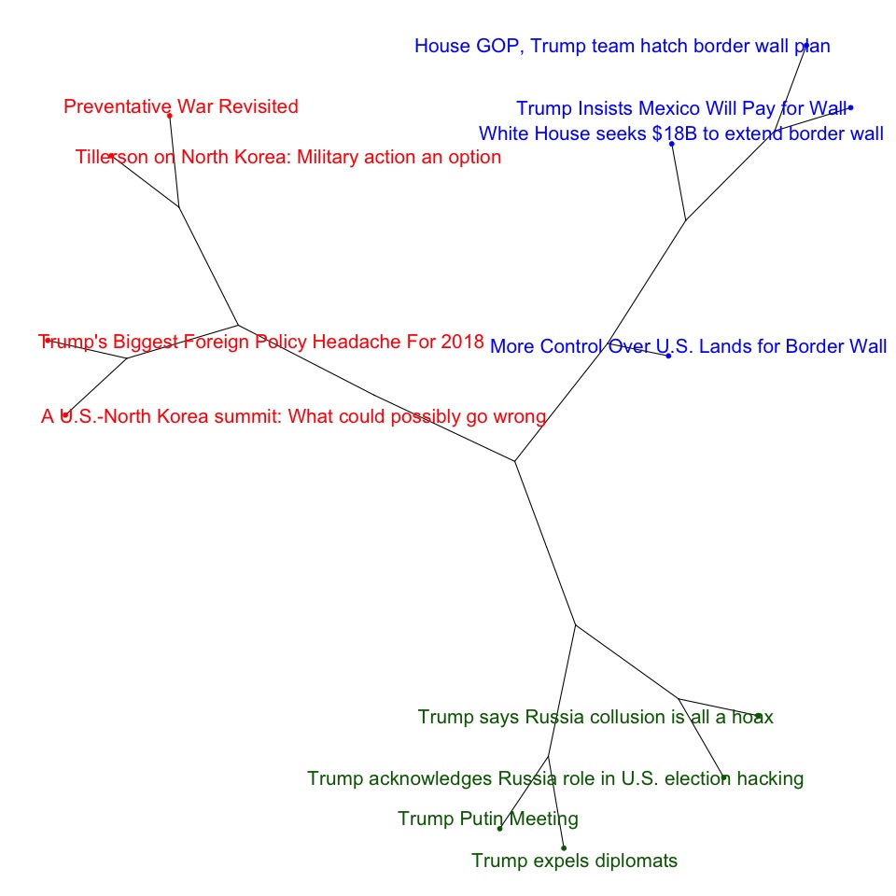
Hierarchical, 3 Clusters

Slide 18
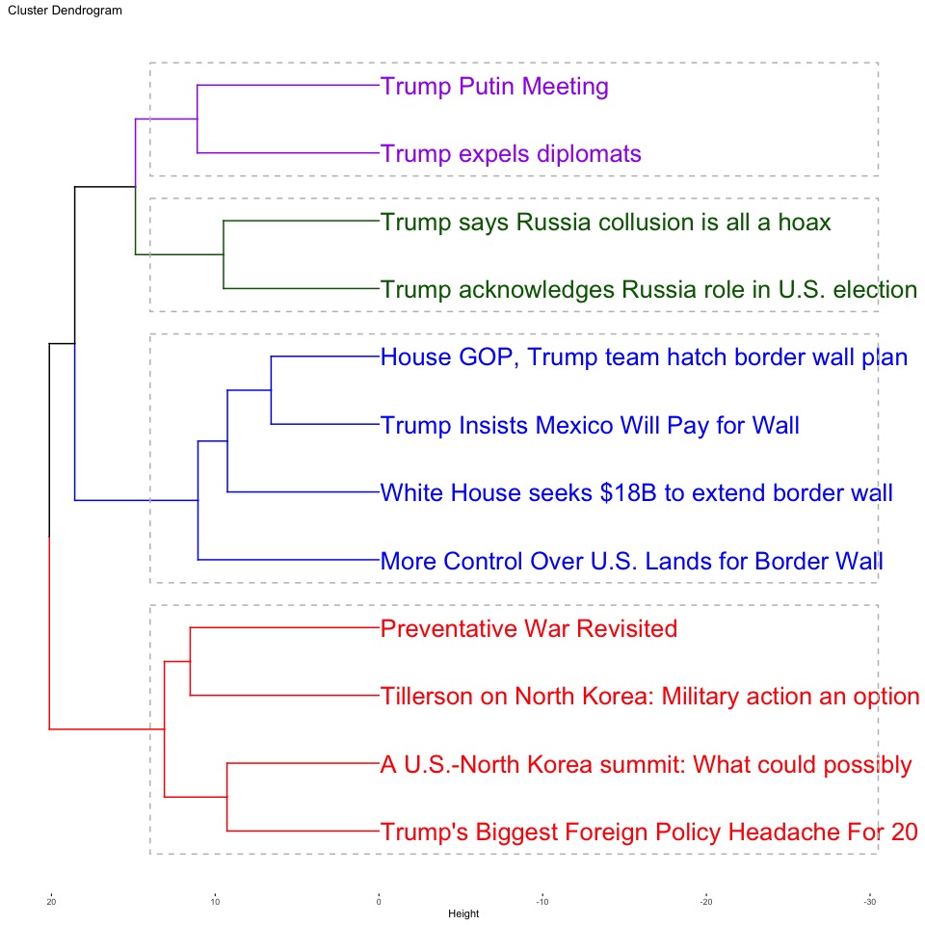
Hierarchical, 4 Clusters The Russia cluster splits into Diplomacy and election interference sub-clusters

Slide 19
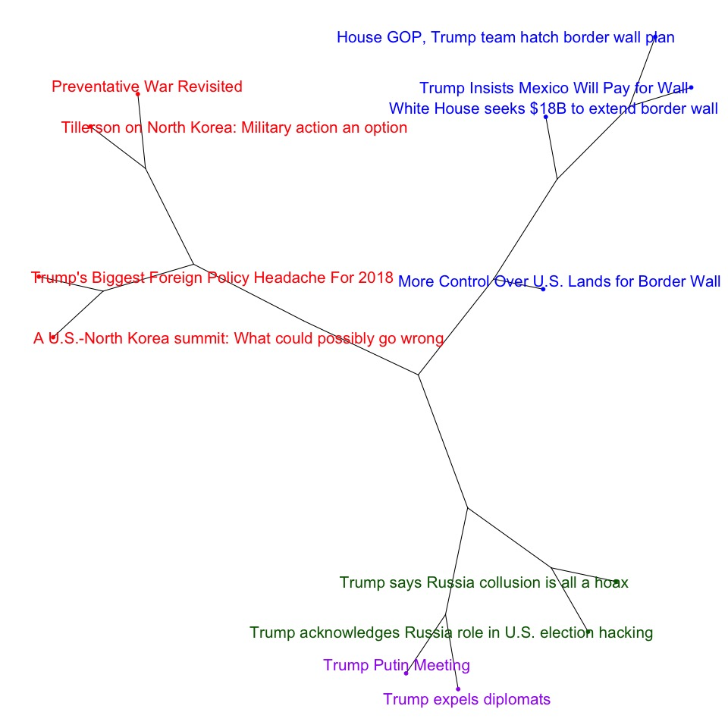
Hierarchical, 4 Clusters

Slide 20
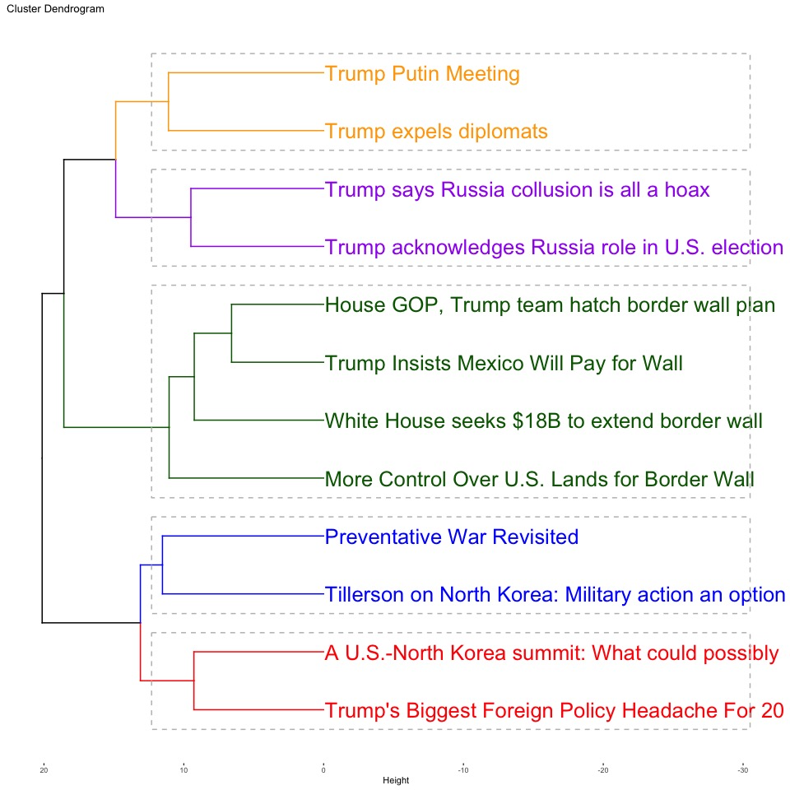
Hierarchical, 5 Clusters The North Korea cluster splits into War and Diplomacy sub-clusters

Slide 21
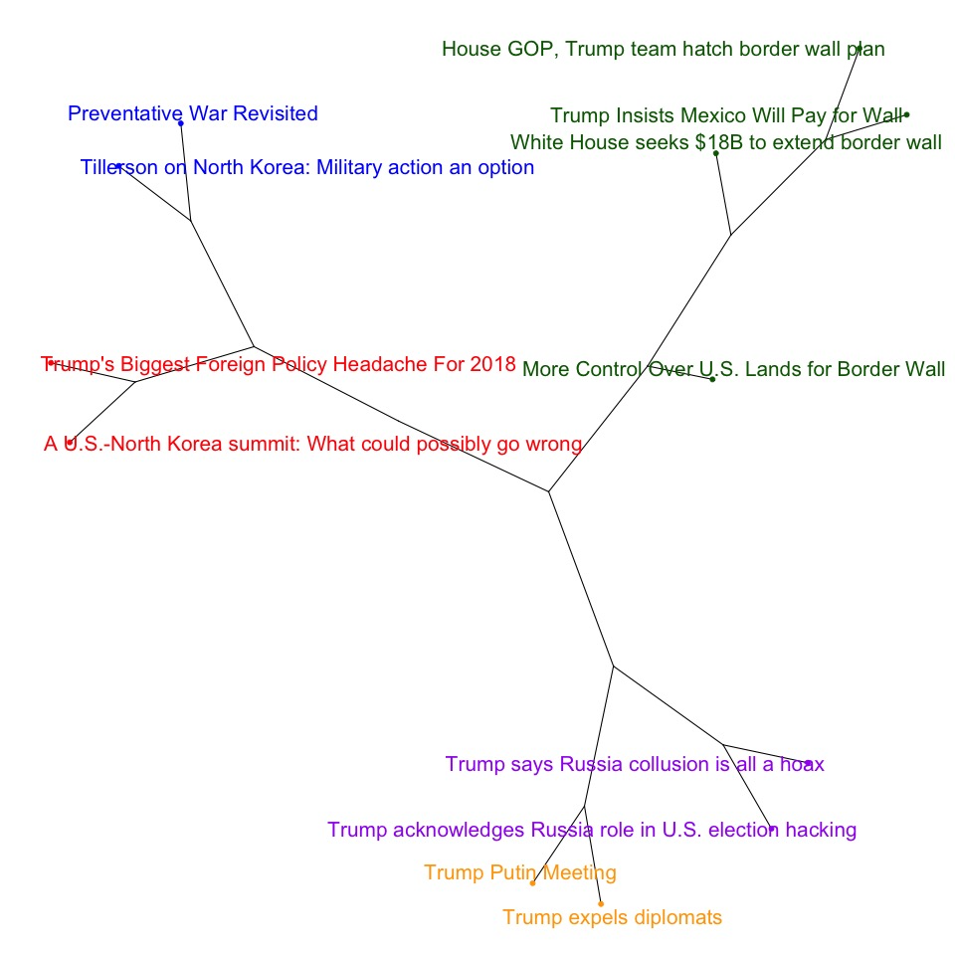
Hierarchical, 5 Clusters

Slide 22
K-Means Clustering
K-Means Clustering analysis with 3, 4, and 5 clusters indicate that there are 3 main clusters, with North Korea and Russia split into the same 2 sub-clusters as Hierarchical Clustering
Border Security with Mexico
North Korea Denuclearization
Preventative war
Diplomatic discussion
Russia
2016 Presidential election interference
Foreign relations

Slide 23
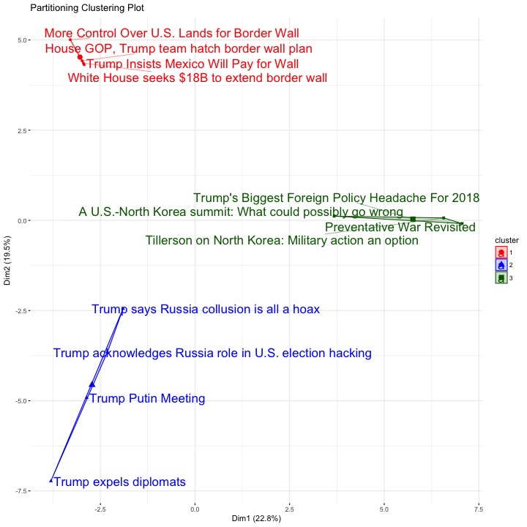
K-Means, 3 Clusters

Slide 24
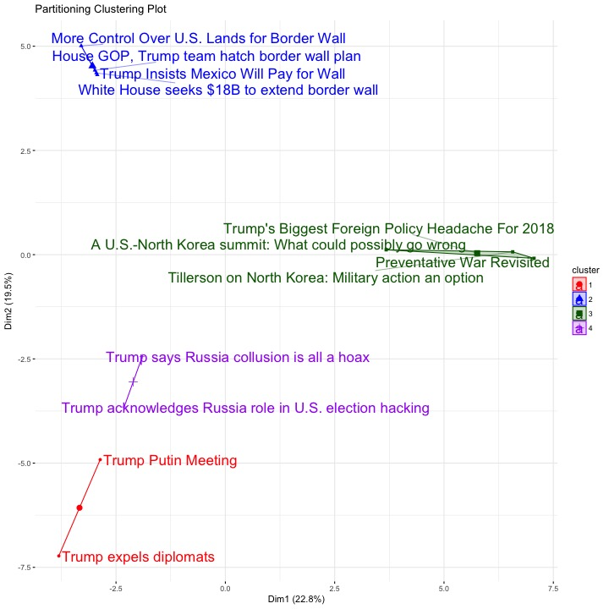
K-Means, 4 Clusters Russia cluster splits into Diplomacy and Election Interference sub-clusters, same as Hierarchical clustering

Slide 25
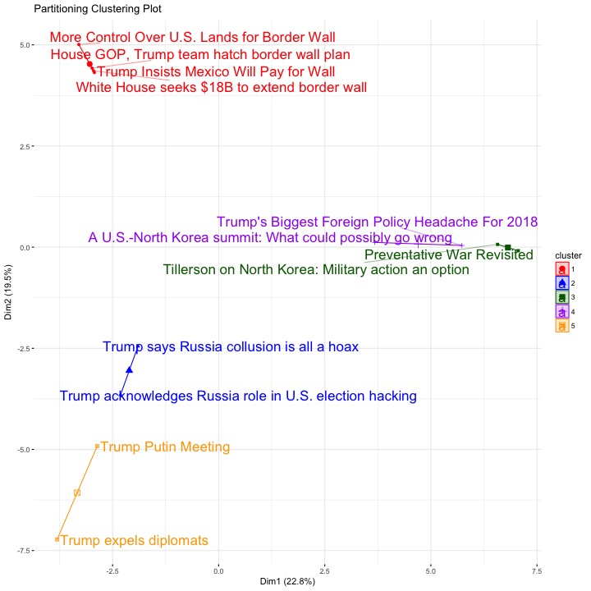
K-Means, 5 Clusters North Korea cluster splits into War and Diplomacy sub-clusters, same as Hierarchical clustering

Slide 26
Determine The Number Of Clusters
Several techniques were used in an attempt to better determine the number of clusters
Elbow Method for k-means clustering
Elbow method for hierarchical clustering
Average silhouette method for k-means clustering
Average silhouette method for hierarchical clustering
Principal Components Analysis
The results of these techniques was inconclusive. Some techniques indicate 5 clusters, others 3.
I decided to use the results of the hierarchical and k-means cluster plots, which indicate 3 main clusters with 2 sub clusters under Russia and North Korea.

Slide 27
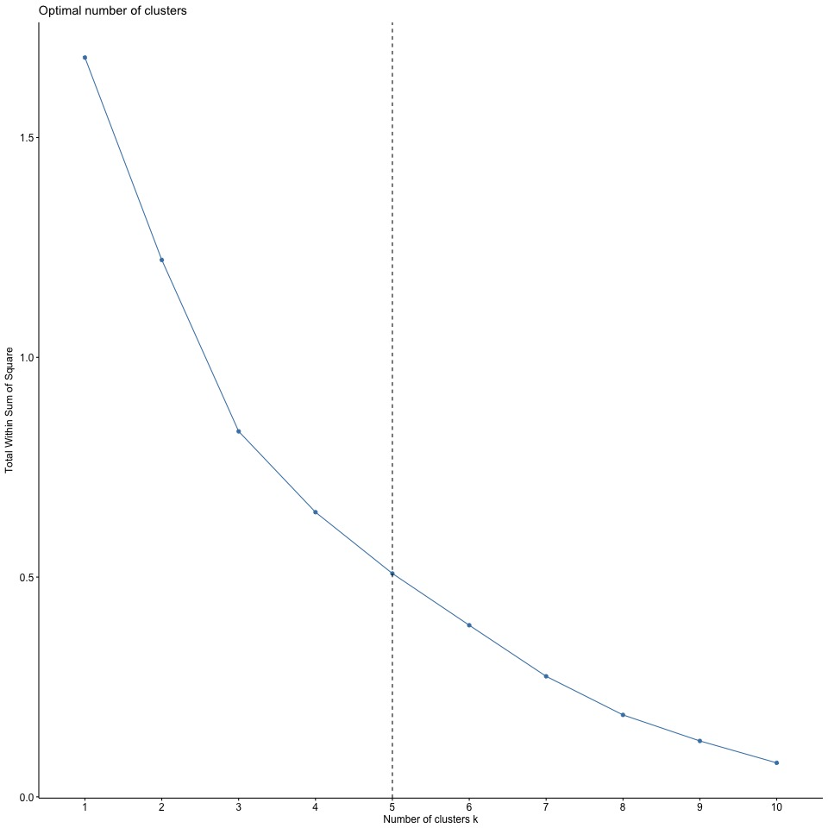
Elbow plot (SCREE plot) for hierarchical clustering indicates 5 clusters

Slide 28
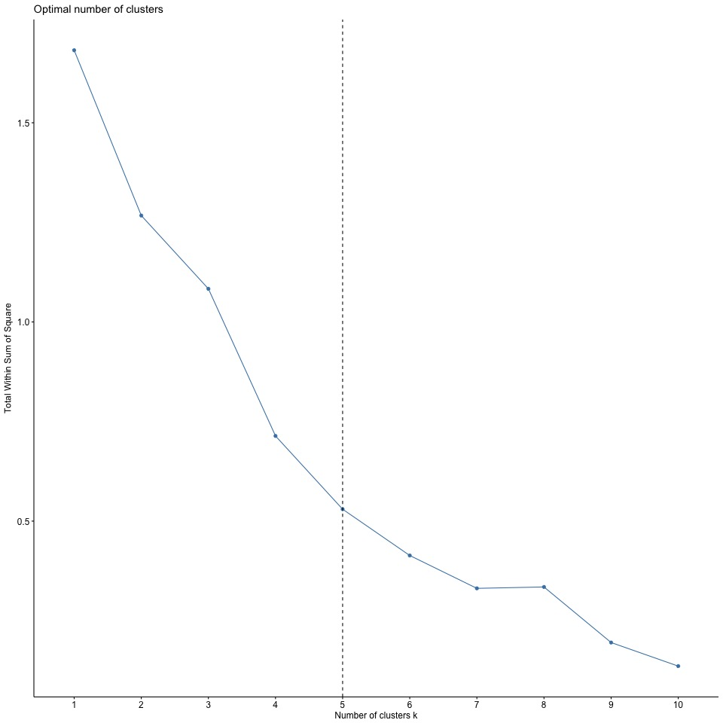
Elbow plot (SCREE plot) for k-means clustering indicates 5 clusters

Slide 29
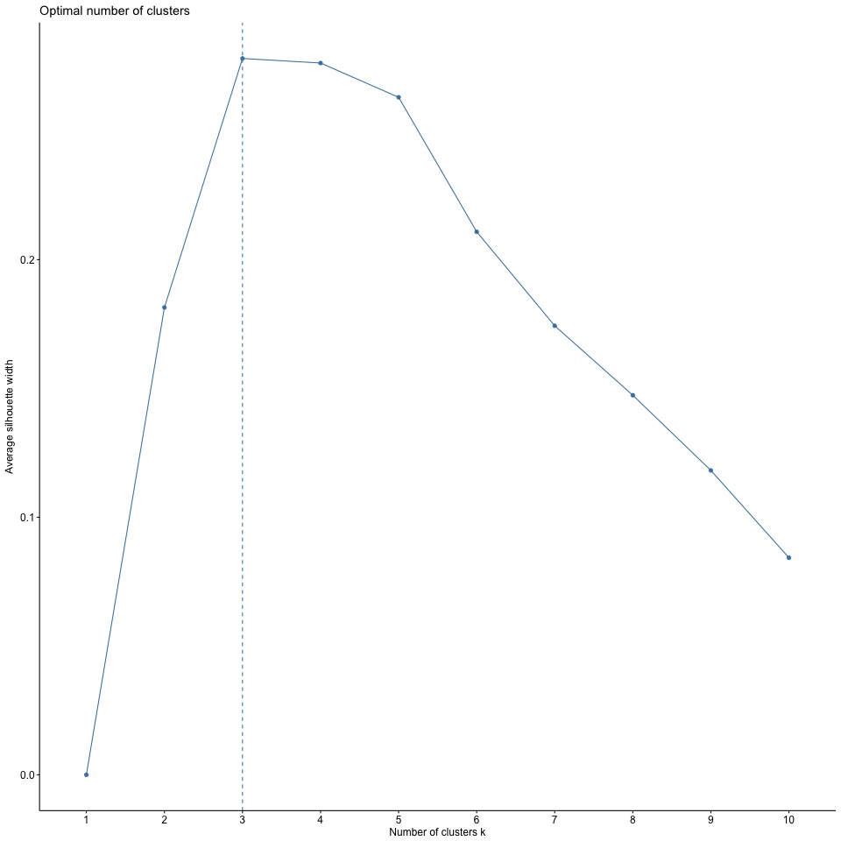
Average Silhouette plot for hierarchical clustering indicates 3 clusters

Slide 30
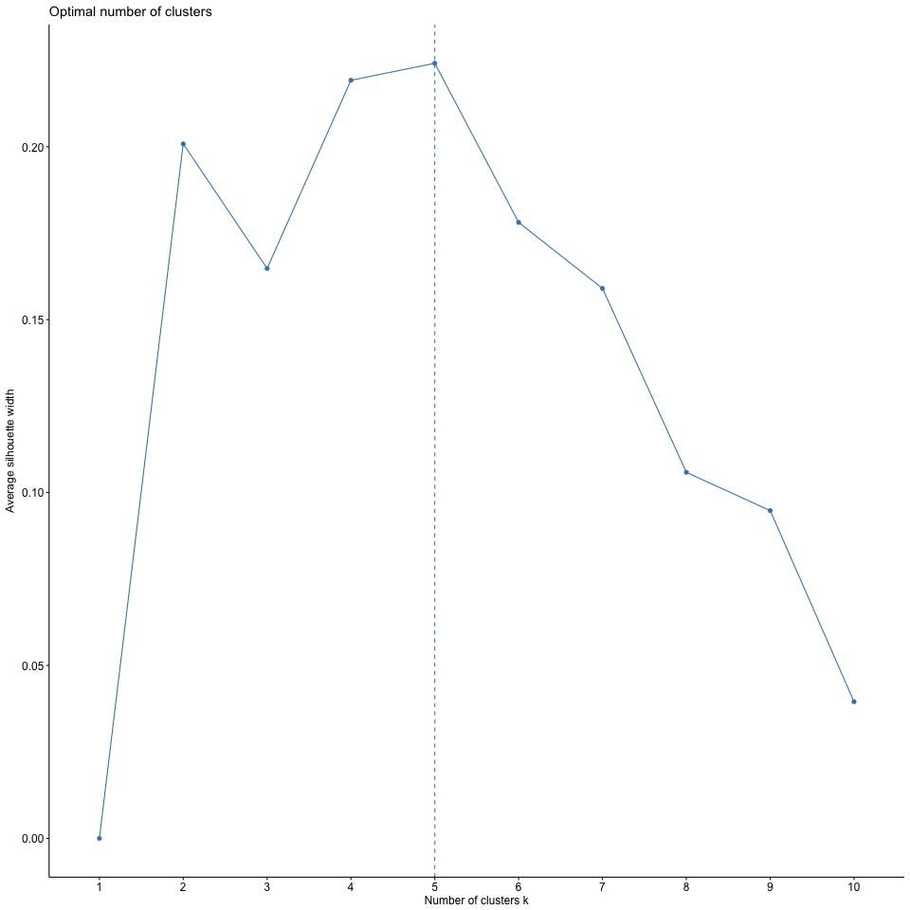
Average Silhouette plot for k-means clustering indicates 5 clusters

Slide 31
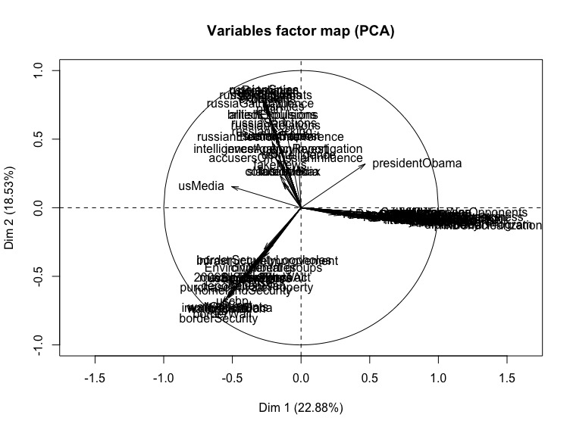
Principal Components Analysis indicates 3 clusters

Slide 32
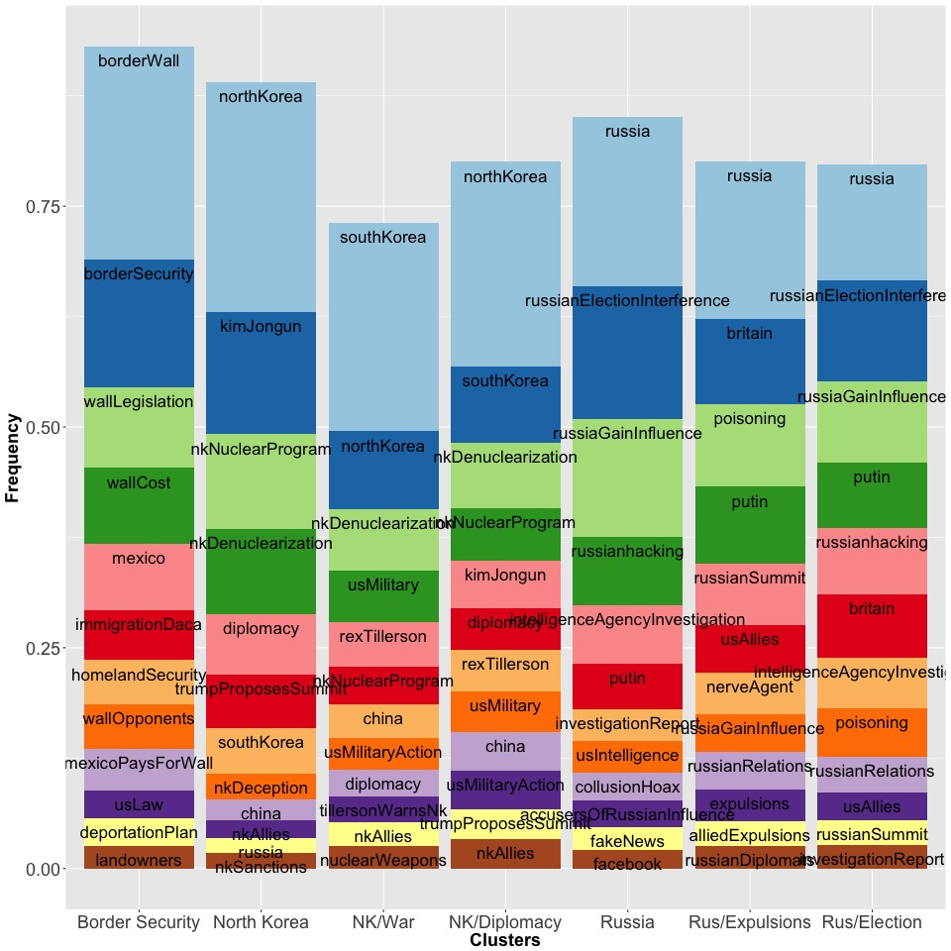
Cluster Term Vectors
The strongest terms for each cluster found by Hierarchical and K-Means was calculated and shown in the plot, ranked in descending order. This creates a term vector for each cluster, including sub-clusters.
Border Security
Top concepts are borderWall, borderSecurity, wallLegislation, wallCost, mexico.
North Korea
The NK/War sub-cluster has concepts such as rexTillerson and usMilitary action ranked highly, while the NK/Diplomacy sub-cluster has diplomacy ranked highly.
Russia
Rus/Expulsions has britain, poisoning, ranked highly, while Rus/Election has russianElectionInterference and russianHacking ranked highly.

Slide 33
Latent Direchlet Allocation
LDA was used to see how well extracted topics match the clusters. The sum of all of the topics that makes up a DSI is 1 (each row sums to 1).
LDA analysis with 3 topics.
Topic 1 is strong with the Border Security DSIs
Topic 2 is strong with the Russia DSIs
Topic 3 is strong with the North Korea DSIs.
LDA with 3 Topics creates the same clusters and K-Means and Hierarchical clustering.
X1 X2 X3
Trump Insists Mexico Will Pay for Wall 0.6598639 0.1700680 0.1700680
House GOP, Trump team hatch border wall plan 0.6529261 0.1752526 0.1718213
White House seeks $18B to extend border wall 0.6945649 0.1552850 0.1501502
More Control Over U.S. Lands for Border Wall 0.6527778 0.1736111 0.1736111
Tillerson on North Korea: Military action an option 0.1118572 0.1172938 0.7708489
Preventative War Revisited 0.0910750 0.1042801 0.8046449
Trump's Biggest Foreign Policy Headache For 2018 0.1190476 0.1404762 0.7404762
A U.S.-North Korea summit: What could possibly go wrong 0.1243781 0.1243781 0.7512438
Trump acknowledges Russia role in U.S. election hacking 0.1149440 0.7680220 0.1170339
Trump says Russia collusion is all a hoax 0.1463485 0.7158321 0.1378194
Trump expels diplomats 0.1155739 0.7707855 0.1136406
Trump Putin Meeting 0.1579450 0.6784189 0.1636360

Slide 34
Latent Direchlet Allocation
LDA analysis with 5 topics.
Topic 1 is strong with Border Security DSIs
Topic 2 is strong with North Korea/Preventative War DSIs
Topic 3 is strong with North Korea/Diplomacy DSIs
Topic 4 is strong with with ‘Trump expels diplomats’
Topic 5 is strong with the other 3 Russia DSIs
The only difference from K-Means and Hierarchical Clustering is the ‘Trump Putin Meeting’ DSI. It was put in the Russia/Election sub-cluster. This is understandable, as this DSI references both the expulsions and the election interference. The topic assignment is weaker than the other topics.
X1 X2 X3 X4 X5
Trump Insists Mexico Will Pay for Wall 0.59183673 0.10204082 0.10204082 0.10204082 0.10204082
House GOP, Trump team hatch border wall plan 0.58082596 0.10309278 0.10309278 0.10663621 0.10635227
White House seeks $18B to extend border wall 0.62922810 0.09009009 0.09009009 0.09551845 0.09507327
More Control Over U.S. Lands for Border Wall 0.58333333 0.10416667 0.10416667 0.10416667 0.10416667
Tillerson on North Korea: Military action an option 0.06711409 0.60282220 0.19251505 0.06711488 0.07043378
Preventative War Revisited 0.05464481 0.63463560 0.19118861 0.06219200 0.05733898
Trump's Biggest Foreign Policy Headache For 2018 0.07142857 0.22779439 0.53649133 0.08538574 0.07889997
A U.S.-North Korea summit: What could possibly go wrong 0.07462687 0.10866637 0.66745303 0.07462687 0.07462687
Trump acknowledges Russia role in U.S. election hacking 0.06896552 0.07141447 0.06896556 0.14912562 0.64152884
Trump says Russia collusion is all a hoax 0.08574406 0.08278424 0.08264463 0.12755664 0.62127043
Trump expels diplomats 0.06876996 0.06821806 0.06802721 0.67572105 0.11926370
Trump Putin Meeting 0.09318627 0.09543784 0.09867922 0.27067159 0.44202508

Slide 35
Latent Direchlet Allocation
LDA analysis with 8 topics. 8 is the most topics where all are strong (close to 50%) in at least 1 DSI.
X1 X2 X3 X4
Trump Insists Mexico Will Pay for Wall 0.13161832 0.06377551 0.06377551 0.06377551
House GOP, Trump team hatch border wall plan 0.25870351 0.06443299 0.06443299 0.06522426
White House seeks $18B to extend border wall 0.13123886 0.05630631 0.05630631 0.05727783
More Control Over U.S. Lands for Border Wall 0.48182117 0.06510417 0.06510417 0.06510417
Tillerson on North Korea: Military action an option 0.04194631 0.10973547 0.10089502 0.04194631
Preventative War Revisited 0.03415301 0.56606218 0.11328815 0.03719528
Trump's Biggest Foreign Policy Headache For 2018 0.04464286 0.10867869 0.42888533 0.05446463
A U.S.-North Korea summit: What could possibly go wrong 0.04664179 0.07533294 0.61657343 0.04664179
Trump acknowledges Russia role in U.S. election hacking 0.04310345 0.04586277 0.04310345 0.09490163
Trump says Russia collusion is all a hoax 0.05197270 0.05171296 0.05165289 0.07212923
Trump expels diplomats 0.04263268 0.04299271 0.04251701 0.62171191
Trump Putin Meeting 0.05695425 0.05956022 0.06280954 0.15744893
X5 X6 X7 X8
Trump Insists Mexico Will Pay for Wall 0.06377551 0.06377551 0.06377551 0.48572862
House GOP, Trump team hatch border wall plan 0.06918445 0.06443299 0.06604413 0.34754468
White House seeks $18B to extend border wall 0.06229990 0.05630631 0.05829545 0.52196903
More Control Over U.S. Lands for Border Wall 0.06510417 0.06510417 0.06510417 0.12755383
Tillerson on North Korea: Military action an option 0.04304106 0.57608803 0.04440149 0.04194631
Preventative War Revisited 0.03495175 0.14417061 0.03602601 0.03415301
Trump's Biggest Foreign Policy Headache For 2018 0.04973252 0.21779309 0.05116002 0.04464286
A U.S.-North Korea summit: What could possibly go wrong 0.04664183 0.07488463 0.04664179 0.04664179
Trump acknowledges Russia role in U.S. election hacking 0.15015439 0.04370123 0.53606964 0.04310345
Trump says Russia collusion is all a hoax 0.07114616 0.05172406 0.59474639 0.05491561
Trump expels diplomats 0.07971454 0.04251701 0.08425623 0.04365790
Trump Putin Meeting 0.45693259 0.05836238 0.08977605 0.05815604
>

Slide 36
Latent Direchlet Allocation
The top terms of each topic. The terms of each topic sum to 1. This indicates the subject of the topic.
Term_1 percent_1 Term_2 percent_2 Term_3 percent_3
1 bordersecurity 0.14802436 southkorea 0.16897709 northkorea 0.32259462
2 walllegislation 0.11475677 usmilitary 0.14009241 kimjongun 0.17452722
3 mexico 0.10552041 usmilitaryaction 0.10318060 nknuclearprogram 0.12046830
4 uslaw 0.08101004 northkorea 0.09688954 nkdenuclearization 0.08988268
5 homelandsecurity 0.07930656 nkdenuclearization 0.08172861 diplomacy 0.07436546
6 borderwall 0.07001290 nknuclearprogram 0.06652052 trumpproposessummit 0.07108562
7 landowners 0.05400655 nuclearweapons 0.04944446 nkdeception 0.03234837
8 environmental 0.04050502 sovietunion 0.03296297 increasednkstatus 0.02176220
9 groups 0.04050502 presidentobama 0.02927521 nkobjectives 0.01940902
landuse 0.04050497 china 0.02751602 japan 0.01844229
Term_4 percent_4 Term_5 percent_5 Term_6 percent_6
1 russia 0.29961180 putin 0.23056176 rextillerson 0.14856536
2 britain 0.11815203 russia 0.17114283 southkorea 0.12586257
3 poisoning 0.08640311 russianrelations 0.12935419 nkdenuclearization 0.11153740
4 usallies 0.08477611 russiansummit 0.11520577 china 0.10719805
5 expulsions 0.06406281 usmedia 0.07684692 northkorea 0.08159256
6 russiagaininfluence 0.06006495 summittopics 0.05760288 nkallies 0.06763289
7 alliedexpulsions 0.04623015 nerveagent 0.03801683 diplomacy 0.06703345
8 russiandiplomats 0.04437741 race 0.02880144 nknuclearprogram 0.06530094
9 usexpulsions 0.04376300 arms 0.02880144 tillersonwarnsnk 0.04396465
nerveagent 0.04031337 presidentobama 0.02697001 nkmilitarypreparedness 0.03744052
Term_7 percent_7 Term_8 percent_8
1 russia 0.21258397 borderwall 0.25043607
2 russianelectioninterference 0.16912899 bordersecurity 0.13410793
3 russiagaininfluence 0.10194915 walllegislation 0.12988835
4 russianhacking 0.10098362 wallcost 0.10970749
5 intelligenceagencyinvestigation 0.08044476 immigrationdaca 0.05794014
6 usintelligence 0.05744198 wallopponents 0.04804125
7 collusionhoax 0.05362986 mexicopaysforwall 0.04579007
8 investigationreport 0.05362983 mexico 0.04081225
9 fakenews 0.03351866 usmedia 0.03785994
10 accusersofrussianinfluence 0.03351796 deportationplan 0.03148703
> >

Slide 37
Latent Direchlet Allocation
LDA analysis with 8 topics. 8 is the most topics where all are strong (close to 50%) in at least 1 DSI.
Legal aspects of building border wall.
Planning for pre-emptive war with North Korea
Diplomatic efforts to denuclearize North Korea
Expulsions of Russian diplomats in retaliation of poison attack
Trump exploring diplomatic solutions in response to Russian election interference
Rex Tillerson's threatening North Korea over their nuclear program (similar to #2 but from a slightly different angle)
Russian election interference
Funding aspects of building the border wall.
Example of the method used to determine Topic 1:
Proportion of Topic 1 in each DSI
Top 10 Terms of Topic 1
Trump Insists Mexico Will Pay for Wall 0.13161832
House GOP, Trump team hatch border wall plan 0.25870351
White House seeks $18B to extend border wall 0.13123886
More Control Over U.S. Lands for Border Wall 0.48182117
Tillerson on North Korea: Military action an option 0.04194631
Preventative War Revisited 0.03415301
Trump's Biggest Foreign Policy Headache For 2018 0.04464286
A U.S.-North Korea summit: What could possibly go wrong 0.04664179
Trump acknowledges Russia role in U.S. election hacking 0.04310345
Trump says Russia collusion is all a hoax 0.05197270
Trump expels diplomats 0.04263268
Trump Putin Meeting 0.05695425
Term_1 percent_1
1 bordersecurity 0.14802436
2 walllegislation 0.11475677
3 mexico 0.10552041
4 uslaw 0.08101004
5 homelandsecurity 0.07930656
6 borderwall 0.07001290
7 landowners 0.05400655
8 environmental 0.04050502
9 groups 0.04050502
10 landuse 0.04050497
The top terms are all related to border security, legislative issues, and stakeholders (environmental groups and land owners). This topic is primarily proportioned to “More Control Over U.S. Lands for Border Wall”.
From this, I conclude that Topic 1 concerns the writing of legislation authorizing the building of the border wall and addresses the impact on land owners and the environment. This topic is addressed to a lessor extent in the other border security DSIs.

Slide 38
Conclusion
Both Hierarchical and K-Means Clustering indicate 3 strong clusters, with fairly significant sub-clusters.
Border Security with Mexico
North Korea Denuclearization
Preventative war
Diplomatic discussion
Russia
2016 Presidential election interference
Foreign relations
Hierarchical and K-Means clustering is consistent with LDA topics except for 1 DSI in the Russia cluster
“Trump Putin Meeting” was grouped in the Russia/Election topic rather than the Russia/Expulsions topic
Term Frequency analysis created term vectors describing each cluster. These vectors can be used by methods such as cosine similarity to determine cluster membership of other DSIs.

